Slide 1
Unit Testing
Subtitle: Ensuring Code Integrity & Maintainability

Slide 2
What is Unit Testing?
Definition
Testing one function at a time :
Unit testing isolates a single function or module and checks its output for known inputs — completely independent of hardware or other modules.
add_values() ← CMock fakes
Real hardware replaced with controlled fakes
2. Goal
Verify logic before integration :
Each function is proven correct in isolation. Bugs are found at the function level — not after
combining 20 modules on real hardware.

Slide 3
Real example — STM32 C code What a unit test actually looks like
Source function (src/math_utils.c)
Unity test (test/test_math_utils.c)
int add_values(int a, int b) { return a + b; }
#include "unity.h" #include "math_utils.h" void test_add_positive(void)
{ int result = add_values(3, 4); TEST_ASSERT_EQUAL_INT(7, result); } void test_add_negative(void)
{ int result = add_values(-2, 5); TEST_ASSERT_EQUAL_INT(3, result); }

Slide 4
Why Unit Testing Matters
The core problem
Embedded bugs are expensive to find late
The later a bug is found in the development cycle, the more it costs to fix. In embedded systems, "late" means on real hardware.
Unit test = 1×
Integration = 10×
On hardware = 50×+
Relative cost to fix a bug at each stage

Slide 5
1× — Unit test stage​
When we find a bug while writing a unit test on PC, it is the cheapest and fastest to fix. You are still writing the function, the code is fresh in your mind, and fixing it takes minutes. No hardware involved at all.​ ​
10× — Integration stage​
When the same bug is only found after combining multiple modules together, it now costs about 10 times more effort to fix. You have to figure out which of the many connected parts caused the problem, the code is no longer fresh, and other code may already depend on the broken behavior.​
50×+ — On hardware stage​
When the bug reaches the real STM32 board, it becomes the most expensive to find and fix. We need physical hardware, a JTAG debugger, an oscilloscope possibly, and many flash-test-observe cycles. The bug might look like a hardware fault when it is actually a software logic error. Tracking it down can take days instead of minutes.

Slide 6
Reason 1 — No hardware needed Tests run on PC in milliseconds
Without unit tests
With unit tests
Write code → compile → flash STM32 → connect JTAG → step through debugger → find bug → repeat. Each cycle takes 2–5 minutes minimum.
Write code → run ceedling test:all → see pass/fail in 3 seconds.
Bug pinpointed by function name and line number. No board, no flash, no cable.

Slide 7
Reason 2 — Early bug detection Catch logic errors before they reach hardware
Typical embedded bug without tests
Same bug with unit tests
Sensor reads wrong value on real hardware. We spend 3 hours with oscilloscope checking SPI signals.
Eventually find it was a unit conversion error in a single function — nothing to do with hardware at all.
Before flashing, we test calls convert_raw_to_celsius() with a known raw value.
It returns the wrong temperature. Test fails in 2 seconds. Bug fixed before any hardware was involved. void test_convert_raw_to_celsi

Slide 8
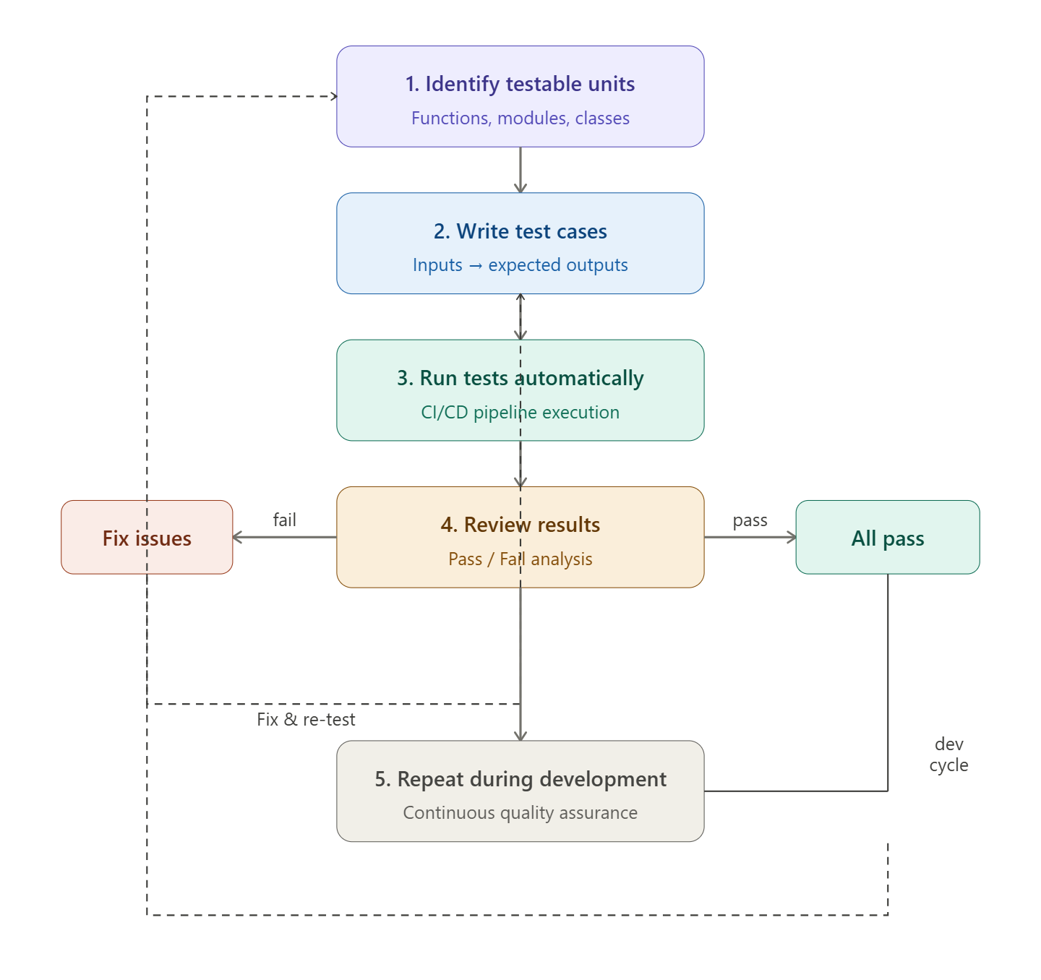
Unit Testing Workflow

Slide 9
Tools for Unit Testing
Think of it like this: Ceedling is the boss that manages everything.
Inside it, Unity writes and checks the tests, CMock fakes the hardware dependencies, and both work on your C source code. STM32CubeIDE plugs into the whole system.
Ceedling
Is the command-line project manager. we can run ceedling test:all and it compiles + runs everything automatically.

Slide 10
Unity
Is the actual test framework. We write TEST() blocks with TEST_ASSERT_EQUAL_INT() macros — like a checklist of "this input should give this output."
CMock
solves the hardware problem. Since STM32 HAL functions need real chips to run, CMock generates fake versions so your tests run on a PC. We tell it "I expect HAL_GPIO_WritePin to be called with these arguments" — and it verifies that automatically.
STM32CubeIDE
Is just your IDE. We configure Ceedling as an External Tool so you can run tests with one click from inside the IDE.

Slide 11
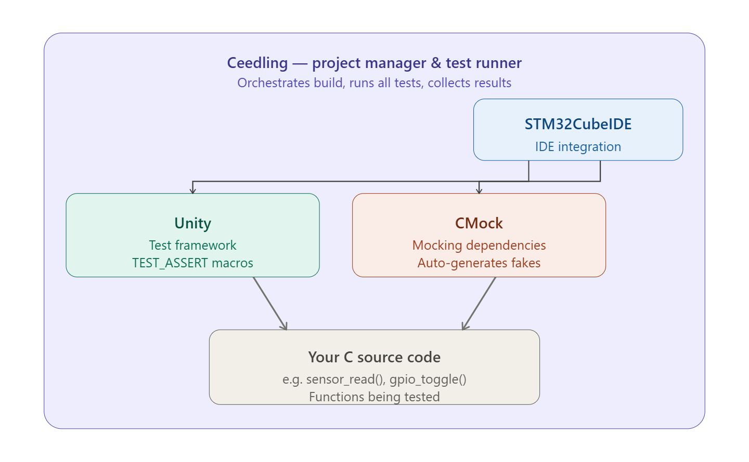

Slide 12
Ceedling — project setup Ceedling uses a project.yml file to configure your project. It tells the build system where your source files, test files, and includes are located.
# project.yml — Ceedling configuration :project: :build_root: build/ :release_build: TRUE :paths: :source: - src/** # Your C source files :test: - test/** # Your Unity test files :include: - include/** # Header files

Slide 13
:plugins: :enabled: - gcov # Code coverage report - junit_tests_report # Run all tests: ceedling test:all # Run one test: ceedling test:test_sensor Ceedling — terminal output $ ceedling test:all ------- Unit Test Summary ------- [PASS] test_sensor_read.c (3 tests) [PASS] test_gpio_toggle.c (2 tests) [FAIL] test_uart_send.c (1 of 4 FAILED) FAILED TEST: test_uart_send_when_buffer_full Expected 0 Was 1 Tests: 9 Failures: 1 Ignored: 0

Slide 14
Unity — source function being tested Suppose we have a C function add_values() in STM32 project:
// src/math_utils.c #include "math_utils.h" int add_values(int a, int b) { return a + b; }
Unity — writing the test
// test/test_math_utils.c #include "unity.h" #include "math_utils.h"

Slide 15
void setUp(void) {} // runs before each test void tearDown(void) {} // runs after each test TEST(test_add_values, adds_two_positives) { int result = add_values(3, 4); TEST_ASSERT_EQUAL_INT(7, result); // PASS: 3+4 = 7 } TEST(test_add_values, handles_negative) { int result = add_values(-2, 5); TEST_ASSERT_EQUAL_INT(3, result); // PASS: -2+5 = 3 } TEST(test_add_values, adds_zeros) { int result = add_values(0, 0); TEST_ASSERT_EQUAL_INT(0, result); // PASS }

Slide 16
CMock — the problem it solves function calls HAL_GPIO_WritePin() — real STM32 hardware. CMock auto-generates a fake version so you can test without any hardware.
// src/led_control.c — the function you want to test
#include "stm32f4xx_hal.h" #include "led_control.h" void led_turn_on(void) { HAL_GPIO_WritePin(GPIOA, GPIO_PIN_5, GPIO_PIN_SET); }
CMock — test with mocked HAL
CMock generates mock_stm32f4xx_hal.h automatically. You tell it what you expect to be called — CMock verifies it happened.

Slide 17
// test/test_led_control.c #include "unity.h" #include "mock_stm32f4xx_hal.h" // CMock auto-generated #include "led_control.h" void test_led_turn_on_calls_hal_correctly(void) { // EXPECT: HAL_GPIO_WritePin must be called once // with these exact arguments HAL_GPIO_WritePin_Expect( GPIOA, // port GPIO_PIN_5, // pin GPIO_PIN_SET // state ); // ACT: call our function led_turn_on(); // CMock automatically verifies the HAL was called // No real hardware needed! }

Slide 18
Step 1 — we have real STM32 firmware that calls HAL_GPIO_WritePin(). That function needs real hardware to run.
Step 2 — CMock reads HAL header and auto-generates a fake mock_stm32f4xx_hal.h. You never write this file yourself.
Step 3 — in the test, declare HAL_GPIO_WritePin_Expect(GPIOA, GPIO_PIN_5, GPIO_PIN_SET) before calling your function. This means: "I expect the HAL to be called with exactly these arguments."
Step 4 — CMock automatically verifies that the call happened, the arguments match, and it wasn't called more times than expected. Zero manual TEST_ASSERT needed for the HAL interaction.
Step 5 — when something goes wrong, CMock tells you exactly which argument failed and what the mismatch was .

Slide 19
Best Practices Keep tests independent
Each test runs alone — no shared state
Bad
Good — setUp resets state
int g_counter = 0; void test_increment_A(void) { g_counter++; TEST_ASSERT_EQUAL(1, g_counter); } void test_increment_B(void) { g_counter++; // FAILS if A ran first! // counter is already 1 TEST_ASSERT_EQUAL(1, g_counter); }
int g_counter; void setUp(void) { g_counter = 0; // reset before each test } void test_increment_A(void) { g_counter++; TEST_ASSERT_EQUAL(1, g_counter); } void test_increment_B(void) { g_counter++; TEST_ASSERT_EQUAL(1, g_counter); // always passes }

Slide 20
Rule: Always use setUp() to reset all variables and mock expectations. A test must produce the same result whether it runs first, last, or alone.
Independent tests — setUp() is your reset button. Every test must start with a clean slate, otherwise one failing test silently corrupts the next one.
The problem: shared state makes tests depend on each other's execution order.
Bad | Good
g_counter = 0 set once globally | setUp() resets it before every test
Test B fails if Test A ran first | Test B always passes regardless of order

Slide 21
Use meaningful test names
Name = function + scenario + expected result
Bad — vague names
Good — descriptive names
void test_led_turn_on_sets_gpio_high(void){ ... }
voidtest_adc_read_returns_zero_on_timeout(void){ }
void test_uart_send_fails_when_buffer_full(void){ ... }
void test1(void) { ... }
void test_gpio(void) { ... }
void test_led(void) { ... }
void test_adc_func(void) { ... }

Slide 22
Pattern: test_[function][scenario][expected] When a test fails, the name alone tells you what broke, under what condition, and what was expected — without reading the code.
Meaningful names — follow the pattern test_[function][scenario][expected]. When CI shows a failure at 2am, the name alone tells you what broke without reading any code
Bad | Good
test1(), test_gpio(), test_led() | test_led_turn_on_sets_gpio_high()
Tells you nothing when it fails | Name tells you exactly what failed and why

Slide 23
Automate test execution
Tests run on every code change
Bad — manual only
Good — CI/CD pipeline
# .github/workflows/test.yml on: [push, pull_request] jobs: unit-tests: runs-on: ubuntu-latest steps: - uses: actions/checkout@v3 - name: Install Ruby + Ceedling run: gem install ceedling - name: Run all unit tests run: ceedling test:all - name: Fail if any test fails run: exit $?
# Developer remembers to run tests
# manually — sometimes forgets
$ ceedling test:all
(only runs when remembered)
# Bug gets merged because
# tests weren't run before push

Slide 24
Goal: No human should need to remember to run tests. Every push triggers them automatically. A failed test blocks the merge.
Automate execution — humans forget; pipelines don't. Wire Ceedling into GitHub Actions or Jenkins so every push triggers a full test run automatically.
The problem: humans forget; automation never does.
Bad | Good
Developer manually runs ceedling test:all | GitHub Actions runs tests on every push automatically
Bugs slip through when forgotten | Every commit is tested — no human needed

Slide 25
Mock hardware dependencies
Replace HAL calls with CMock fake
Bad — calls real HAL
Good — CMock intercepts
// test directly calls HAL
void test_led_on(void) {
led_turn_on();
// How do we verify GPIO was set?
// We can't — no real hardware.
// Test crashes or does nothing.
TEST_ASSERT_TRUE(1); // meaningless
}
#include "mock_stm32f4xx_hal.h" void test_led_on_drives_gpio_high(void) { // CMock intercepts this HAL call HAL_GPIO_WritePin_Expect( GPIOA, GPIO_PIN_5, GPIO_PIN_SET ); led_turn_on(); // CMock verifies args automatically // No hardware needed — runs on PC }

Slide 26
Principle: Your test should verify your logic, not the HAL. Mock every hardware-facing call so tests run anywhere, instantly, without a board connected.
The problem: without mocking, you can't test hardware logic on a PC.
Bad | Good
Calls real led_turn_on() — can't verify GPIO | HAL_GPIO_WritePin_Expect() intercepts the HAL call
Crashes without real hardware | Runs on any PC, CMock verifies arguments

Slide 27
Benefits for Our Team
Faster debugging in STM32 projects
Confidence in firmware updates
Easier collaboration & code reviews
Long-term maintainability

Slide 28
Conclusion
Unit testing is not optional — it’s essential
With Ceedling + STM32CubeIDE, we can integrate seamlessly
Next step: Set up test framework in our project

